Slide 1
SemEval 2019 Subtask
Xihao liang
http://alt.qcri.org/semeval2019/index.php?id=tasks

Slide 2
Opinion, emotion and abusive language detection
Task 3: EmoContext: Contextual Emotion Detection in Text
Task 4: Hyperpartisan News Detection
Task 5: HatEval: Multilingual Detection of Hate Speech Against Immigrants and Women in Twitter
Task 6: OffensEval: Identifying and Categorizing Offensive Language in Social Media

Slide 3
Task 3: EmoContext: Contextual Emotion Detection in Text
Task Description
In this task, you are given a textual dialogue i.e. a user utterance along with two turns of context, you have to classify the emotion of user utterance as one of the emotion classes: Happy, Sad, Angry or Others. ​ ​
Data Set
The training data set will contain 15K records for emotion classes i.e., Happy, Sad and Angry combined.
It also contains 15K records not belonging to any of the aforementioned emotion classes.
https://www.humanizing-ai.com/emocontext.html

Slide 4
Task 3: EmoContext: Contextual Emotion Detection in Text
Train: 30160 samples
Dev: 2755 samples
id | turn1 | turn2 | turn3 | label
0 | Don't worry I'm girl | hmm how do I know if you are | What's ur name? | others
1 | When did I? | saw many times i think -_- | No. I never saw you | angry
2 | By | by Google Chrome | Where you live | others
13 | Bad | Bad bad! That's the bad kind of bad. | I have no gf | sad
28 | You are very funny | so I've been told | India | happy
Label | # of Samples
Happy | 4243
Angry | 5506
Sad | 5463
Others | 14948
id | turn1 | turn2 | turn3
0 | Then dont ask me | YOURE A GUY NOT AS IF YOU WOULD UNDERSTAND | IM NOT A GUY FUCK OFF
1 | Mixed things such as?? | the things you do. | Have you seen minions??
2 | Today I'm very happy | and I'm happy for you ❤ | I will be marry
3 | Woah bring me some | left it there oops | Brb

Slide 5
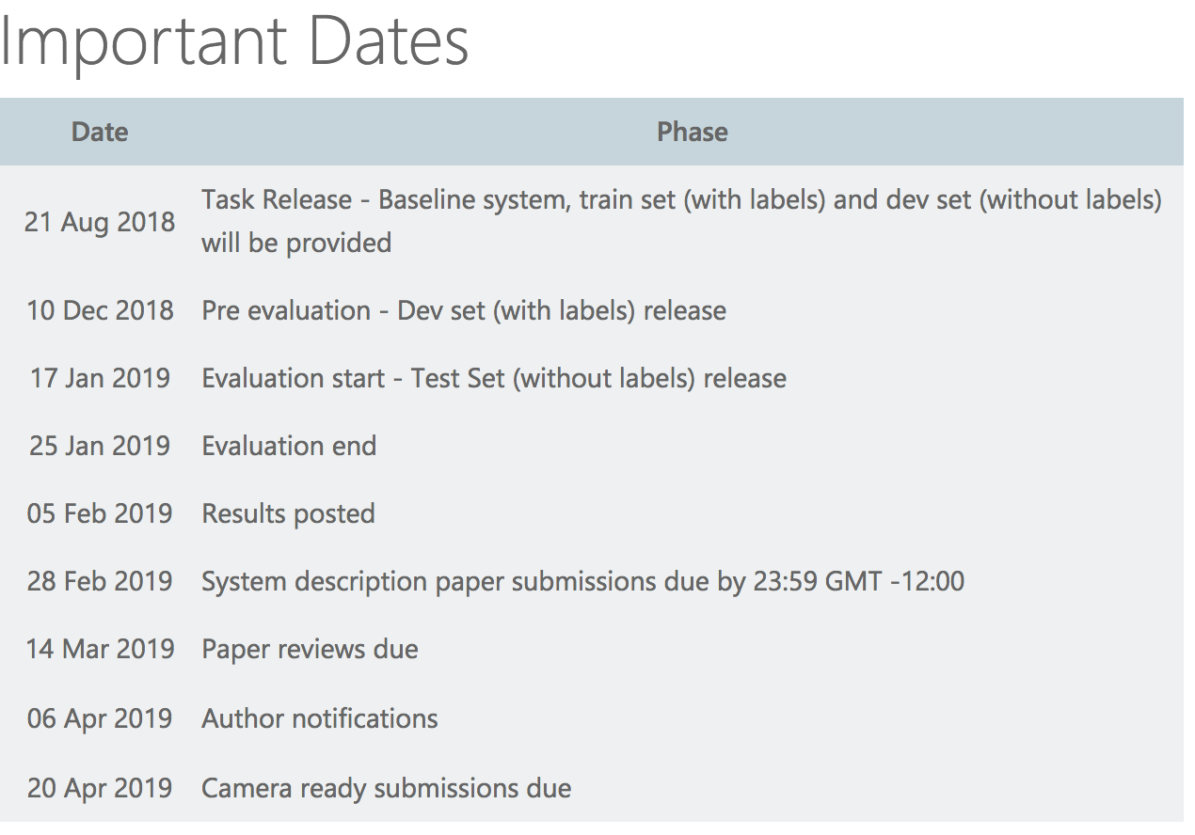
Task 3: EmoContext: Contextual Emotion Detection in Text

Slide 6
Task 4: Hyperpartisan News Detection
Task
Given a news article text, decide whether it follows a hyperpartisan(偏袒的) argumentation
i.e., whether it exhibits blind, prejudiced, or unreasoning allegiance(忠诚) to one party, faction, cause, or person.
Data Set
We will provide 1 million articles labeled by the overall tendency of the publisher for training your algorithm.
https://pan.webis.de/semeval19/semeval19-web/

Slide 7
Task 4: Hyperpartisan News Detection
File Name | # of Articles
./pan19-hyperpartisan-news-detection-by-article-training-dataset-2018-11-22/articles-training-byarticle-20181122.xml | 832
./pan19-hyperpartisan-news-detection-by-publisher-training-dataset-2018-11-22/articles-training-bypublisher-20181122.xml | 1346293
./pan19-hyperpartisan-news-detection-by-publisher-validation-dataset-2018-11-22/articles-validation-bypublisher-20181122.xml | 351171
./pan19-hyperpartisan-news-detection-training-dataset-2018-08-31/articles-training-20180831.xml | 1807995
./pan19-hyperpartisan-news-detection-validation-dataset-2018-08-31/articles-validation-20180831.xml | 482523

Slide 8
Task 5 - Shared Task on Multilingual Detection of Hate (hatEval)
Hate Speech is commonly defined as any communication that disparages (贬低) a person or a group on the basis of some characteristic
such as race, color, ethnicity, gender, sexual orientation, nationality, religion, or other characteristics.
The proposed task consists in Hate Speech detection in Twitter
featured by two specific different targets, immigrants and women
in a multilingual perspective, for Spanish and English.
https://competitions.codalab.org/competitions/19935

Slide 9
Task 5 - Shared Task on Multilingual Detection of Hate (hatEval)
TASK A - Hate Speech Detection against Immigrants and Women
a two-class (or binary) classification
whether a tweet in English or in Spanish with a given target (women or immigrants) is hateful or not hateful.
TASK B - Aggressive behavior and Target Classification
first to classify hateful tweets for English and Spanish (e.g., tweets where Hate Speech against women or immigrants has been identified) as aggressive or not aggressive
second to identify the target harassed as individual or generic (i.e. single human or group).

Slide 10
Task 5 - Shared Task on Multilingual Detection of Hate (hatEval)
Dataset
English
Train/Dev/Trial 9000 /1000/100 samples
Espanol
TrainDev/Trial: 4500/500/100 samples
Label
HS: a binary value {1|0} indicating if hate speech is occurring against one of the given targets, women or immigrants
TR: if HS=1, a binary value indicating if the target is a generic group of people (0) or a specific individual (1)
AG: If HS=1, a binary value indicating if the tweeter is aggressive (1) or not (0)
id | text | HS | TR | AG
201 | Hurray, saving us $$$ in so many ways @potus @realDonaldTrump #LockThemUp #BuildTheWall #EndDACA #BoycottNFL #BoycottNike | 1 | 0 | 0
202 | Why would young fighting age men be the vast majority of the ones escaping a war &amp; not those who cannot fight like women, children, and the elderly?It's because the majority of the refugees are not actually refugees they are economic migrants trying to get into Europe.... https://t.co/Ks0SHbtYqn | 1 | 0 | 0
203 | @KamalaHarris Illegals Dump their Kids at the border like Road Kill and Refuse to Unite! They Hope they get Amnesty, Free Education and Welfare Illegal #FamilesBelongTogether in their Country not on the Taxpayer Dime Its a SCAM #NoDACA #NoAmnesty #SendThe | 1 | 0 | 0

Slide 11
Task 6: OffensEval: Identifying and Categorizing Offensive Language in Social Media
Motivation
Offensive language is pervasive in social media. Individuals frequently take advantage of the perceived anonymity(匿名) of computer-mediated communication, using this to engage in behaviour that many of them would not consider in real life. Online communities, social media platforms, and technology companies have been investing heavily in ways to cope with offensive(冒犯的) language to prevent abusive behaviour in social media.
In OffensEval we break down offensive content into three sub-tasks taking the type and target of offenses into account.
https://competitions.codalab.org/competitions/20011

Slide 12
Task 6: OffensEval: Identifying and Categorizing Offensive Language in Social Media
Subtasks
Sub-task A - Offensive language identification
Sub-task B - Automatic categorization of offense types
Sub-task C - Offense target identification

Slide 13
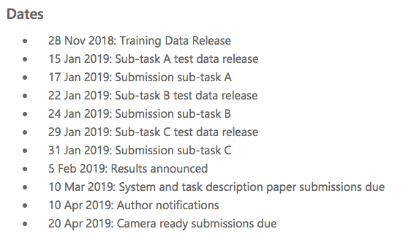
Task 6: OffensEval: Identifying and Categorizing Offensive Language in Social Media

